Slide 1
Customer Scrutiny
15th July 2011
Jane Taylor - Customer Inspector
Val Bagnall - Executive Director
Being a Great landlord

Slide 2

Sentinel HA
Based in North Hampshire –8,000 homes, Created from 2 LSVTs in early 1990’s
Strong neighbourhood and customer focus
5 tenant Board members out of 13
90% of customers consider we provide and efficient & effective service
89% consider we provide the service they expect
92% of customers would recommend us to friends or families
Overall customer satisfaction 92%

Slide 3
Resident Scrutiny- Why?
GETTING AND DELIVERING THE RIGHTSERVICE OFFER -!
An integral part of Co -regulatory environment
A key element of the Annual Assessment report for customers & TSA
Big Society & local accountability
Proofing of our service delivery, as part of good governance
A central element of our Customer Involvement Strategy

Slide 4

Key considerations for developing scrutiny
Membership – number, profile, skills, representation
Recruitment
Payment or incentives
Support needs - administration
Budget / cost considerations/VFM
Links with Corporate management/governance- who does it report to, and how does it communicate its function
Which model or approach
Determining priorities for scrutiny
Setting safeguards
Fit with other involvement structures/roles

Slide 5
‘Customer Deal’
Sentinel’s Service Offer
Details
    Scope of all our services
    Standards set for each service area
Proofing the Customer Deal
    1500 qualitative comments from customers
    Focus groups on TSA standards: The Home, Involvement (complaints, disability, BME), Tenancy, Community & Neighbourhood, VFM, leaseholders
    Residents Week – Questionnaire
    Housemark Local Standards Tracking Service
Performance framework agreed with customers
Creation of scrutiny methodology to ensure delivery

Slide 6
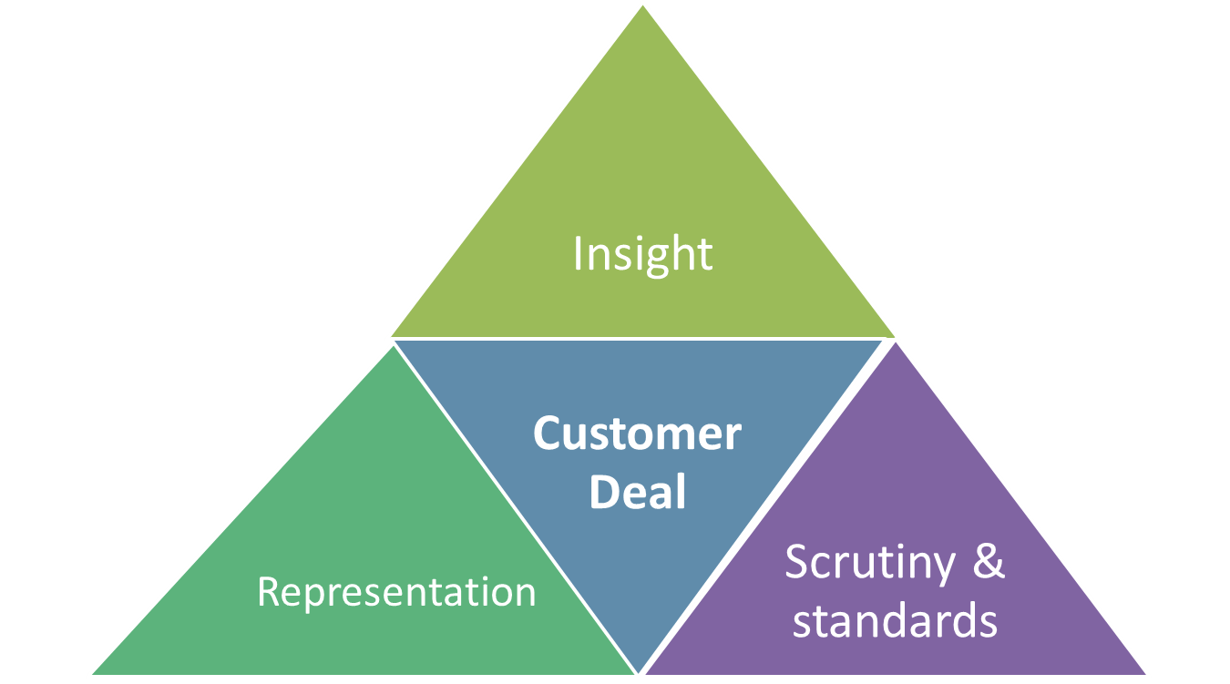
Proofing & developing our Customer Deal

Slide 7
Current scrutiny arrangements
Performance
Service evaluation
Benchmarking
VFM Grou
p
PI reporting STARA & Web
Focus Groups
Service Reviews
Tenant
Complaints tracking
Board
Job interviews
-
induction
Members
Customer Deal
Challenge
STARA
Board
STARA
Accountability
Feedback
Customer Inspection
Disability forum
Key Services
Focus Groups
Peer Review
Satisfaction /surveys
Estate Inspections
Complaints & compliments
Comprehensive feedback programme
Snagging inspection
Residents week & community events
Reality checking
Neighbourhood Panels

Slide 8
TSA Standards
‘Customer Deal’
Sentinel’s
Local Offer
The Home
Involvement
Community &
neighbourhood
Tenancy

Slide 9
Scrutiny- The Home
88% satisfied with quality of home -83% satisfied with the overall repair service
Customer Inspection of Maintenance service – Oct 10
Customers involved in monthly contractor meetings, and all procurements
Design Panel
Void inspections
Mystery shopping
Snagging Inspections
Customer reps doing repair service survey calls

Slide 10

Scrutiny – Tenancy
95% satisfied with Lettings Service
Customer Inspection of lettings process – June 11
Customer involvement in development of new tenancy agreement – plain English
95% satisfaction target set for all new lettings
Customer consultation on Affordable Rent regime

Slide 11
Scrutiny – Community & Neighbourhood
91% satisfied with neighbourhood : 89% think Sentinel have good reputation in area
Customer Inspection of Estates Service – Sept 11
Neighbourhood Panels, with clear focus and role
Residents involved directly in LSP partnerships
Estate Inspectors – 19 trained
Strong involvement of local councillors in what & how we do business – Qtrly meetings
Clear objectives and targets for each neighbourhood area/team – Report to Neighbourhood Panels
Development of Neighbourhood Charters with Local Agencies & Customers

Slide 12

Scrutiny –Involvement
85% satisfied that views taken into account
Five Customer Representatives on Board
Sentinel Tenants & Residents Association (STARA)
Hampshire & Districts Residents Forum – all key housing providers working together to deliver Involvement Standard for Hampshire
Achievement of Customer Excellence Standard
Customer Inspectors
Development of joint Customer Inspector team: Sentinel/Kingfisher Sovereign/ Testway HA
Disability Forum
Interviewing of all frontline staff
Residents Week
Random checking of Complaints handling
Review of Service Improvement Plan

Slide 13
A Customer Inspector’s experience

Slide 14
An INSPECTION
      AN INSPECTOR CAME TO CALL
      - One resident inspector’s experience

Slide 15
An inspection
APPROACH
SELECTION
TRAINING
INSPECTION ALLOCATION
PLANNING
INSPECTION
DEBRIEF

Slide 16
THE POSITIVES
Self esteem and development
Use of existing skill set
Working with like minded people
Sense of involvement
Level of training and support
Degree of assistance and facilitation
Renumeration

Slide 17
THE NEGATIVES
Insufficient time frame for inspection
Personal shoehorning and juggling
Lack of objectivity and hidden agendas
Freeloading
Personality clashes
Lack of checks and balances
Training

Slide 18
RECOMMENDATIONS
Recruitment & Selection
Training
Inspection Procedures, Checks & Planning
The Inspection Process & Transparency
Debrief and Conclusions
Timescales
Renumeration

