Slide 1
A Home, A Job, A Future
Katie Teasdale, External Affairs Manager

Slide 2

Housing associations USP:
unique relationship with residents
operate in deprived areas
take a long-term view of communities
are major employers with strong supply chains
invest in success
understand the local labour market
have strong relationships partners
Notes:
This new research report highlights the unique offer that housing associations have to make on the employment and skills agenda.

Slide 3
IPSOS Research Results
39% of housing associations currently offer employment and skills support,
….with a further 28% planning to do so in the future
32% see supporting their residents, and the wider community, into employment, education or training as a top priority.
Notes:
It includes new data from research commissioned from IPSOS which emphasises the breadth of the existing housing association offer, how associations have strong partnerships locally to support delivery, and that the sector as a whole has the appetite to do more.

Slide 4
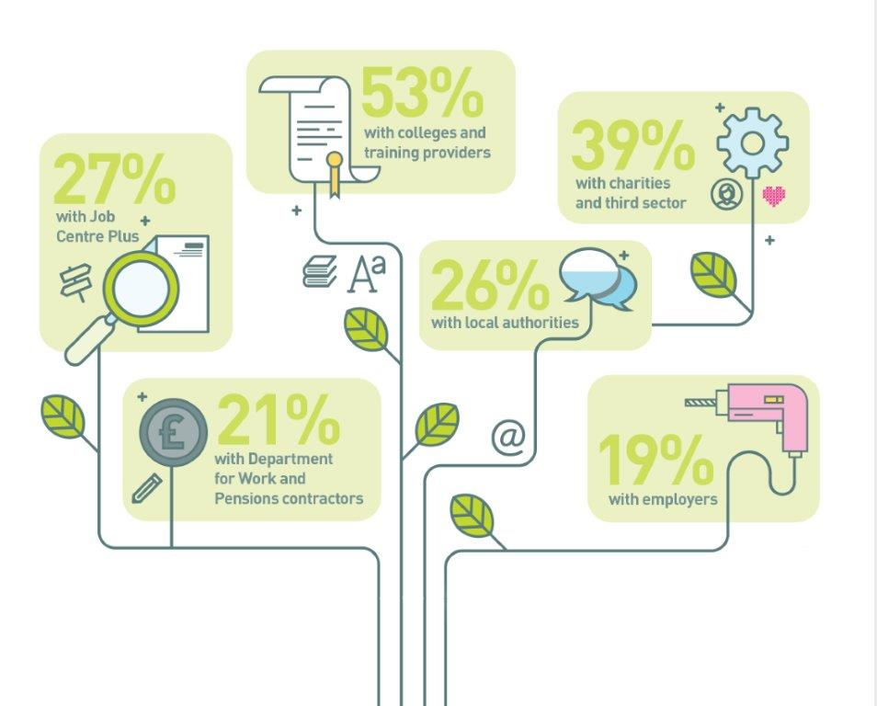
Working with local partners
Notes:
Established partnerships

Slide 5
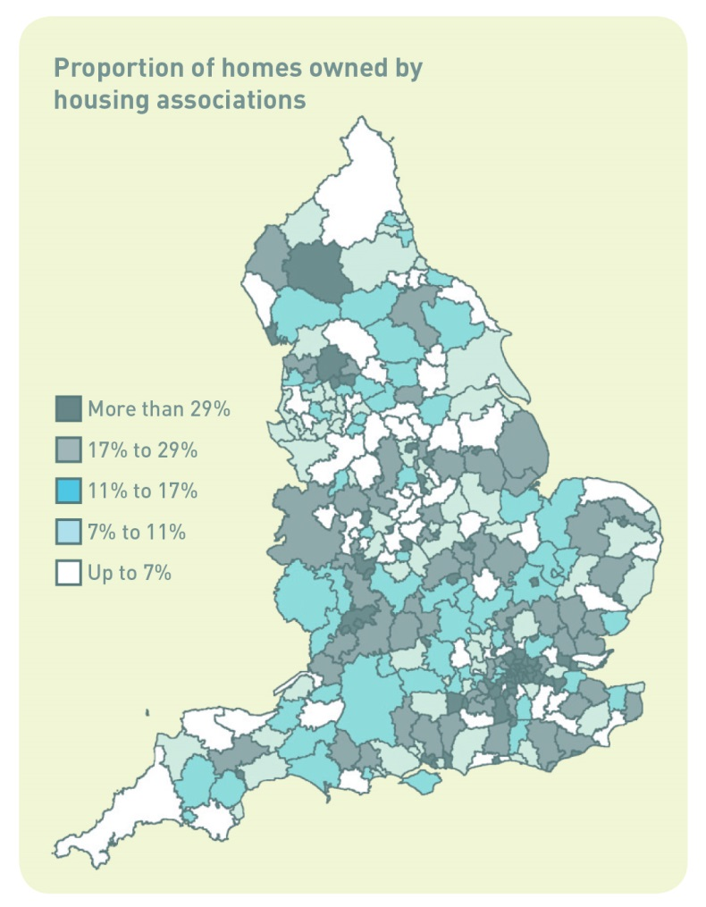
Case Studies
Affinity Sutton: Ready2Work
Aspire Group: PM Training
Calico: Constructing the Future
Coast & Country: Journey into Work
Family Mosaic: Employment Boot Camp
Yarlington: Household Ambition Plan
Bromford: The Bromford Deal
GUAC: Working in Partnership

Slide 6

Conclusion
strong offer on employment and skills
crucial partners in future design and commissioning of employment programmes
unlocking expertise and investment opportunities
trusted providers in hard to reach communities

Slide 7

www.housing.org.uk
#AHomeAJobAFuture

