Slide 1



Welcome to our Unconference
We are encouraging networking today!

Slide 2

Domestics!
Fire Alarm/Exits
Breaks
Lunch
Toilets
Smoking

Slide 3
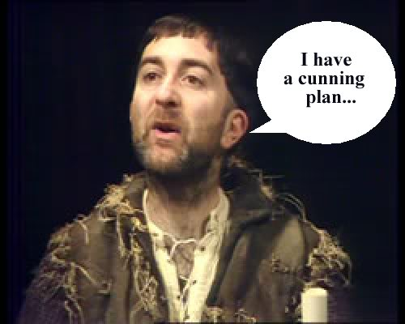
The cunning plan for today
10.30 New Governance Standard
11.00 Networking one
12.00 Feedback
12.30 Lunch – Yum!
1.30 Networking two
2.30 Feedback
2.55 Prize draw
3.00 Close

Slide 4
New Governance and Financial Viability Standard
Published: 30th Jan 2015
Yvonne Davies
Scrutiny and Empowerment Partners Limited
Yvonne@tenantadvisor.net
07867974659

Slide 5

HCA response to consultation
Consultation paper May 2014
152 responses
Regulation decision instrument
New regulations and a new code of practice to be published from 1st April 2015
New demands on risk management, stress testing and records of assets and liabilities – whatever the size of the business

Slide 6

New Governance & Financial Viability Standard
The Board must:
Adhere to all relevant law
Comply with their governing documents and all regulatory requirements
Be accountable to tenants, the regulator and relevant stakeholders
Safeguard taxpayers’ interests and the reputation of the sector; have an effective risk management and internal controls assurance framework
Protect social housing assets
Manage their resources to ensure viability is maintained while ensuring that social housing assets are not put at undue risk.

Slide 7

What is new?
More emphasis on risk management
Control at Group Parent for all “entities”
Records of assets and liabilities
Limit of 5% non social housing activities
Stress testing the Business
Rent standard at the consumer price index
Higher rent – options for landlords to charge this for £60k households
Be careful of contracts which tie you into another entity
Stock Disposal
New landlord registrations
Definitions in a new code of practice

Slide 8

What does this mean for Boards (1)
Adopt a code of governance – NHF or UK code?
Clear roles and responsibilities between Board and Staff
Communicate to the regulator - non compliance
Assess the effectiveness of governance at least one a year
Manage their affairs with appropriate skills, independence, diligence, effectiveness prudence and foresight
Ensure an appropriate, robust and prudent business planning risk and control framework
Report fraud and losses
A culture of constructive challenge and debate and good governance practices
Internal and external review of progress
Have access to sufficient liquidity at all times, including timing of cash flows to manage cash flow risk.

Slide 9

What does this mean for Boards (2)
An independent Board
Skilled and capable to perform their functions
Data returns - quality and timely
Sufficient information to enable a potential buyer to accurately price the value of the business and/or value of the Social Housing assets in the event of distress and produce this at short notice for the regulator.
Targets and measures and monitor financial performance to ensure headroom for covenants
Reporting requirements
Boards need to assure themselves on compliance each year the RP needs to assure themselves of continuing compliance – e.g. development or contract and assurance should be annual, narrative and in the round on all Regulatory Standards

Slide 10

How can involved customers help?
Does your role as an involved customers include:
Holding your landlord to account for meeting regulatory standards?
Holding your landlord to account for their promises on services – like service standards?
Challenging performance information
Commenting on new Policies
Scrutiny of services
Reviewing Complaints
Do you report on this once a year?
Where?
Could you start doing this as part of your role and feed into Board/Committee reporting?

Slide 11

Thanks for listening - Any questions?
It is time to reinvent business focussed
customer involvement– go an seize the moment!
Yvonne@tenantadvisor.net
07867974659

Slide 12

Workshops

Slide 13

Feedback

Slide 14

Name Badges

Slide 15


Thanks for supporting the conference
Yvonne@tenantadvisor.net
07867974659

