Slide 1



Welcome to our Unconference
We are encouraging networking today!
#scrutiny15
Wi-fi - Guest
LWire08
livewire

Slide 2
New thinking
- housing and involvement
Yvonne Davies
Scrutiny and Empowerment Partners Limited
Yvonne@tenantadvisor.net
07867974659

Slide 3

What we are going to cover
3 reports on involvement
Government election mandate - housing
July 2015 budget - housing

Slide 4

Involvement - happenings

Slide 5


Recent reports on resident involvement
Tenants Leading Change – An investment, not a cost – the business benefits of tenant involvement
Amicus Horizon - Success, satisfaction and scrutiny – the business case for involving residents
Family Mosaic - Changing Places – how can we make resident involvement relevant?

Slide 6

Tenants Leading Change report
University of Birmingham
Financial, service, social and community benefits
5 case studies, call for evidence and workshops
Financial benefits – VFM attributed in part to CI in 20 landlords - £6.64m or £29 per property - £118m in total across the sector
5 case studies £3.90M annual verified £94 per property - £382m total across the sector
Service benefits almost all reported tenant oriented services – better than consultants over time
Shaping neighbourhoods, scrutiny and involvement in governance – most effective
Surveys, market research and on line involvement – less so
Trust – communications on Welfare reform
Tacking ASB and regeneration programmes - community

Slide 7

Tenants Leading Change report (2)
Tenant Management and tenant knowledge
Social dividend- support networks, meeting neighbours, tackling isolation and engage diverse groups
Confidence, skills and employment, inspiring staff
Satisfaction –causality - 38% of staff reported a link

Slide 8

Success, satisfaction and scrutiny
Case studies – procurement, complaints and customers experience £2.7m pa savings against a £950K investment
97% satisfaction – due to effectiveness of involvement
Residents as co-producers, consultants, designers, testers and provide direct feedback on services
One team culture of staff, board and residents - 5 gold model KPIs
Effective in conversations which are open and based on trust – Board attend Panels
University of Westminster
Notes:
Embedding involvement and aligning goals
Creating a resident governance structure; BM attendance at area panels and one team culture; 5 gold medal KPIs – best landlord by 2016
Complaints (£180K):
solution focused, central team, chairing stage 3
Procurement (£2.3m):
Recruitment; identifying VFM; resident monitors for post work inspections and performance review

Slide 9


Changing Lives
No more traditional involvement groups
Major change in approach
More surveys
Better use of insight data
Focusing on local empowerment of active citizens to replace the demise of TARAs
Better use of social media
…………..Not yet proven – 5 studies to follow

Slide 10



New Government – happenings

Slide 11

May 2015 - Conservative promises
New Government – new Policies
Right to Buy
New Homes
Housing Zones
Welfare Changes
Human Rights and immigration

Slide 12

Right to Buy
Extend RTB to 1.4 million HA tenants living in their home for 3 or more years
35% discount, rising at 1% a year to 70% (up to £78,000)
LAs to fund this by selling off their most expensive property
HA receipts to create a £1billion brownfield fund

Slide 13

Brownfield plans and Housing Zones
Help LAs to fund LAs to clean up unused land
LAs to prepare a register of sites
90% must have planning permission by 2020
20 Housing Zones outside London – to build another 45,000 homes
5,500 of these in the north west – Wirral, Preston, Blackburn and Darwen
Notes:
A ‘housing zone’ is an area of land where the government provides funding to unlock the scheme – such as infrastructure, site acquisition and leaseholder buyouts.
The developer and local authority commit to providing a certain level of affordable and private housing, and must meet these targets on deadline as a condition of the funding.

Slide 14

New Starter and Affordable Homes
200,000 new starter homes
First time buyers under 40 years
Sold at 20% below the market value (after 5 years you can sell)
275,000 affordable homes by 2020 (50,000 a year of the 100,000 needed for a number of years now)
LAs must help self builders
Simplify planning system

Slide 15

Human Rights and Immigration
Immigration Bill to make it easy to evict illegal immigrants
Requirement for private landlords to check immigration status of tenants
Consultation on Bill of Rights to replace the Human Rights Act

Slide 16


What else?
Cities an devolution Bill – elected mayors and delivery of Greater Manchester type deals to take over delivery of services
Draft Public Service Ombudsman Bill – combine the housing, health, L Govt and Parliamentary Ombudsman services

Slide 17
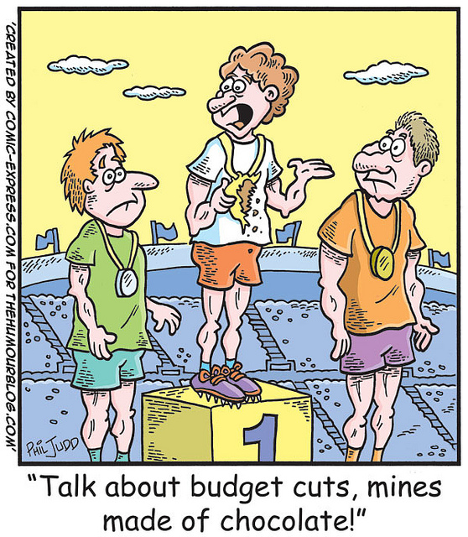
July 2015 Budget - happenings

Slide 18

July 2015
Budget Summary
The benefit cap reduced from £26,000 to £20,000 by 2016/17
Working age benefits frozen for four years, together with other welfare changes
Social housing rents to be reduced by 1% each year over the next four years
End to lifetime tenancies
£30k earners will have to pay closer to market rent

Slide 19

Benefits
Working age benefits, inc HB frozen for 4 years
The benefit cap reduced from £26,000 to £20,000 by 2016/17 (£500 to 385 a week up north)
No automatic HB for 18-21 year olds
Tax credits reduced from £123.46 a week to £74.04 (48p in every £)
2017 – first child – parent to work at 3 years and no extra child benefit for first child
2018 – mortgage interest – becomes a loan
Notes:
The chancellor announced a number of measures intended to reduce spending on welfare:
The overall benefit cap, currently set at £500 per week (£26k per year) for a working age household with children, will be reduced to £385 (£20k per year) or £442 (£23k per year) in London
Housing benefit (HB) will be frozen for four years from April 2016, along with both child and working tax credits and a number of other working age benefits, including jobseekers’ allowance (JSA), employment and support allowance (ESA), income support and child benefit
Under universal credit (UC) the work allowance (the amount a claimant is allowed to earn in wages before their UC award begins to be reduced) will be abolished entirely for non-disabled, childless households. For all other households whose claim includes housing costs, it will be reduced to £44.30 per week (£192 per month)
From April 2016 the income threshold for tax credits (equivalent to the work allowance for UC) will also be reduced from £123.46 per week to £74.04. In addition, the taper rate (the rate at which tax credits are then withdrawn) will be increased from 41% to 48%. This means that for every extra pound a claimant earns over £74.04, their tax credits will be reduced by 48p
From April 2017 18-21 year olds submitting a new claim for UC will not be automatically entitled to receive the housing costs element (the equivalent of HB). There will be exceptions for:
those who are parents and whose children live with them
vulnerable groups
those who had previously been living independently and working continuously for 6 months
From April 2017 18 -21 year olds receiving UC will also be subject to a new youth obligation. They will be expected to participate in a programme of support at the start of their claim and to apply for an apprenticeship or traineeship, gain work place skills or go on a work placement after six months
From April 2017 new claimants in the ESA work-related activity group (those who receive the lower rate of ESA) will only be paid the equivalent of JSA. This is a reduction of £29 per week, however they will still receive additional support to help them seek work
From April 2017 both the child element of UC and child tax credits will be limited to a maximum of two children in most cases. This will affect new UC claimants and households who have a third (or subsequent) child born after April 2017. However child benefit will still continue to paid on third and subsequent children
From April 2017 the family element in tax credits, the first child premium in UC and the family premium in HB will all be abolished. In effect this means that the amounts paid for a first child will no longer be more generous than they are for subsequent children. Similarly, this will affect new UC claimants and households who have a first child born after April 2017
From April 2017 parents claiming UC, including lone parents, will be expected to prepare for work when their youngest child turns two and to look for work they turn three
From April 2018 payments made under the support for mortgage interest scheme will no longer be non-repayable. Instead they will be made as loans, which will be repaid either upon the sale of the home or when the recipient returns to work

Slide 20

Rent reduction at 1%pa for 4 years
Current business plans assume a rent plus 1% increase, plus CPI (forecast at 0.9% in September 2015)
Details coming out
In reality a 2.9% decrease in income in year one
Impact on business plans- 14% reduction
Less income = reduced or services, or some services no longer delivered

Slide 21

Pay to Stay
Tenants in social housing who earn more than £30,000 per year in the north will be expected to pay market or near market rents
LAs expected to pay the extra money raised to the Exchequer to help with deficit reduction
HAs expected to reinvest the money to build more homes
Government will be consulting on the detail of this measure

Slide 22

Lifetime tenancies
Government will review the use of ‘lifetime tenancies’ for social housing with the aim of limiting their use and ensuring that best use is made of stock
HCA said they will be encouraging shared ownership and some affordable rents last week (social rents only if case can be made)
Creation of help to buy ISAs, which will be available to savers from December 2015

Slide 23

New regulation -
Deep Dive inspections
Pilots:
  St Vincent’s
  London and Quadrant
Pilot Feb to June
Now in legislation
Can be used for consumer standards – but not expected
Message to HAs – consider merger before you ask for exemptions

Slide 24

Consumer standards - protected
Tenant involvement = cross cutting standard
Scrutiny Panel or similar
Performance
Policy
Complaints information
Choice
Annual reports
RTM and repairs cashback engagement
Statutory consultation – changes in management
Value For Money statement – Stakeholder involvement in look back and forward

Slide 25

Over to you – Discussion
Government Policy
Changes made in the budget
Suggestions for involvement
Another 12billion to go from the budget – not sure exactly where yet!
All this and more up for discussion now and in the unconference networking

