Slide 1
Changing Customer Engagement
26 April 2016
Steven Dawson & Peter Eldrett

Slide 2
Background to East Durham Homes
East Durham Homes Limited is a charity and a Community Benefit Society.
We are now a Registered Provider of social housing with approximately 8,300 homes in East Durham.
Initially established in 2004 as an ALMO
We are now a landlord in our own right following stock transfer in April 2015.
Part of County Durham Housing Group, together with Dale & Valley Homes and Durham City Homes with around 19,000 homes in the group.

Slide 3
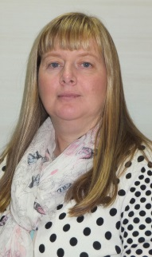
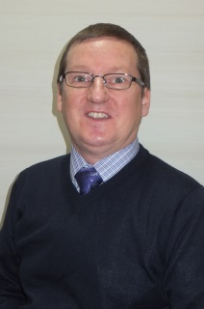
Customer Involvement Team
Peter Eldrett
Customer Involvement Manager
Steven Dawson
Customer Involvement Officer
Carole Tilley
Customer Involvement Officer
Ian Straughan
Customer Involvement Officer

Slide 4
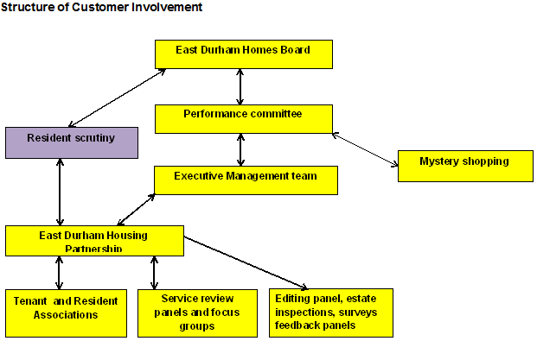
Structure of Customer Involvement

Slide 5
Current methods of Customer Engagement
Customer Satisfaction surveys
STAR survey
Complaints
Insight tenants’ newsletter
Customer Involvement bulletin
Annual report
Website
Social media
Suggestion scheme

Slide 6
Customer Satisfaction surveys
Currently use Vision Management Software (VMS)
Used for performance information
Opportunity to comment on services received
847 completed surveys 2015/16
Rectification notices

Slide 7
STAR Survey
50% random sample in July/August 2015
1126 responses (27%)
17% would like to get involved with decision making
Only 4% dissatisfied with opportunities to get involved.
Top 6 areas to get involved surveys, mystery shopping, estate inspections, newsletters, email and a Customer Panel

Slide 8
Complaints
177 informal complaints
93 stage 1 complaints
4 stage 2 complaints
1 stage 3 complaint
No referrals to the Housing Ombudsman
23 improvements to services as a result of complaints “You Said, We Did”

Slide 9
Insight tenants’ newsletter
Currently produced 3 times a year
Used to update on relevant news and to promote services and events
Currently put together through an editing panel
Main way of providing regular information

Slide 10
Annual report to tenants
Changed to a calendar format this year
Listed meeting dates until December 2016

Slide 11
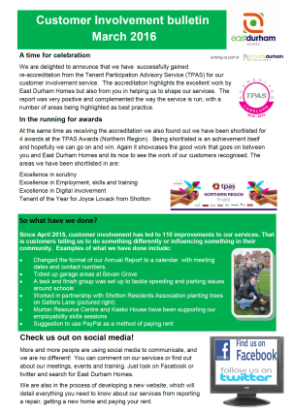
Customer Involvement bulletin
Developed in October 2015
Sent out with the rent statements
Promotes Customer Involvement
Promotes outcomes from Customer Involvement
Promote social media and online presence
Promotes upcoming events

Slide 12
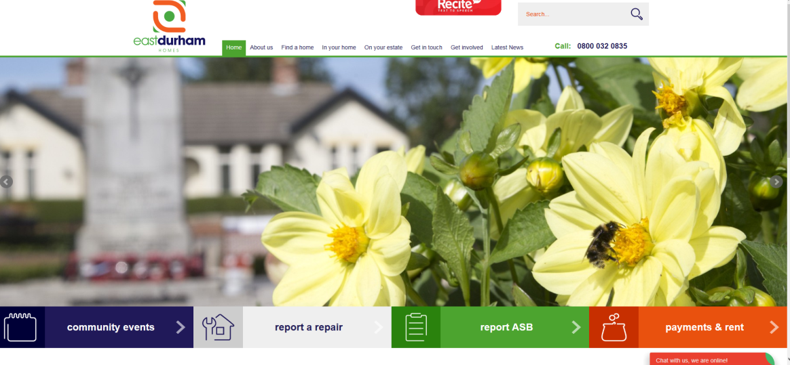
Website
New website launched recently
More user friendly and better accessibility
Live chat
Community events calendar

Slide 13
Social media
1,250 likes on Facebook
2,153 followers on Twitter
Use local Community pages
Some groups have their own pages
Promote events and meeting
Advertise hard to let properties

Slide 14
Suggestion scheme
Opportunity to suggest improvements to services
Leaflets and suggestion box in reception areas
Used less – 1 suggestion in 2015/16

Slide 15
What next?
Developing an email Panel
Survey Monkey
Mail chimp
My Place / App?

Slide 16
Email panel
Came out of a scrutiny panel recommendation
Have a list of around 1,800 email addresses
Initially sending out the Customer Involvement bulletin
Next step to do a training needs survey
Plan is to develop the panel for consultation including scrutiny reviews, service reviews as well as promoting events, training and meetings

Slide 17
Survey monkey
Exploring the use of Survey monkey
First survey will be around training needs
Plan is to find out what information customers would like to receive
Will use for scrutiny reviews
Will use for Service Reviews
Plan to use to get feedback on a range of services

Slide 18
Mail chimp
Will use to personalise emails
More professional
Can link to information on the website
Should increase the number of customers we engage with
Will engage with younger customers, customers in work and families

Slide 19
My Place / app
My Place currently available through the website
Portal for customers
Can check rent, report repairs and ASB
Limited to what it can do
Looking at developing My Place or looking to develop an app
Dependant on a new Housing Management system across the Group

Slide 20
Positives
Engage with a greater number of customers
Engage with hard to reach groups and individuals
Instant communication
Free so excellent VFM
Increase take up at training and events
Making the best use of technology

Slide 21
Concerns
Large number of customers not online
Contact information changes regularly
Reduces face to face contact
Increase social isolation
Dilutes involvement and empowerment

Slide 22
The future for East Durham Homes
Currently undergoing a review of Customer Engagement across the Group. Uncertain on the future of the role and the impact it will have on our customers.
Report and recommendations due soon

Slide 23
A little quote
"If you always do what you've always done, you'll always get what you've always got.“
Henry Ford (1863-1947)

Slide 24
Discussion time?

