Slide 1

Welcome to Scrutiny.Net
Darlington 5th October 2016
Yvonne Davies
Scrutiny and Empowerment Partners Ltd
www.tenantadvisor.net

Slide 2

Housekeeping

Slide 3

Changing our approach to co-regulation and involvement
- Alison and Jayne

Slide 4
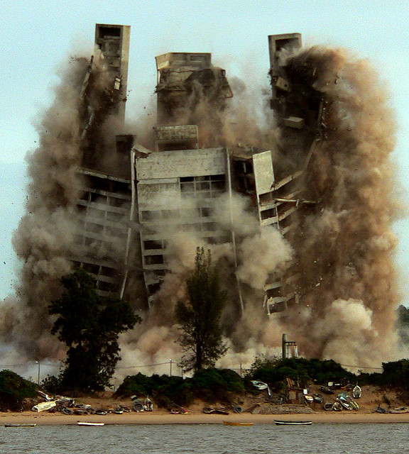
Tenant involvement in organisational change, merger, acquisition and collapse of groups
…and the devolution of LAs
Different approaches to organisational change
Matthew on Thirteen Group collapse
Involving tenants in change – test of opinion or Ballot
Devolution

Slide 5





What a difference a year makes…
Notes:
Perceptions audit
Ambition to Deliver outlined clearly where the sector wanted to be and how it wanted to be perceived.
However, We wanted to better understand decision makers’, opinion formers’ and the public’s views of housing associations. So we interviewed politicians, media and think tanks from across the political spectrum, and carried out polling of the general public. Research was delivered by sector experts Webber Shandwick.
To know us is to love us
Politicians that had interacted with associations valued the sector more – even when they were more aware of the sector’s shortcomings.
Those who didn’t have much interaction with the sector talked of negative aspects of the sector in an unsubstantiated way.
Our focus has been on promoting work of associations and winning over new govt in a post Brexit environment

Slide 6

Different types of change
Merger
Group collapse
Restructure – business process re-engineering
New customer base and diversification of stock and business
Sharing of services
Joint procurement
Cost sharing groups
VAT saving groups
Joint ventures
Other cost-saving options – stock swaps, staff swaps etc

Slide 7

Consultation requirements
What to look out for
Intra group Agreement
Promises – (not always for 5 years)
Funders and sometimes LA shareholder votes
Shareholders – including Board votes
Regulatory requirements and permissions– now and post March – (likely H&P Act date)
Funders requirements post March – de-regulation
Regulatory requirement “consultation should set out the costs and benefits of the change”

Slide 8


Test of Opinion v Ballot
Introductory newsletter
Internet
Phone calls
Door knock
Survey – soft test
2nd newsletter – more detailed info on how to vote
Service offer
2nd test of opinion (2-3 weeks) – or ballot (usually 4+ weeks)

Slide 9

Measuring success
Are you setting:
  Response rates?
  Geographical identifications?
  Number attending meetings and number of public meetings?
What is the question?
  Why change?
  What are the options?
  Do you understand what is being said?
  What are the pros and cons of change?

Slide 10
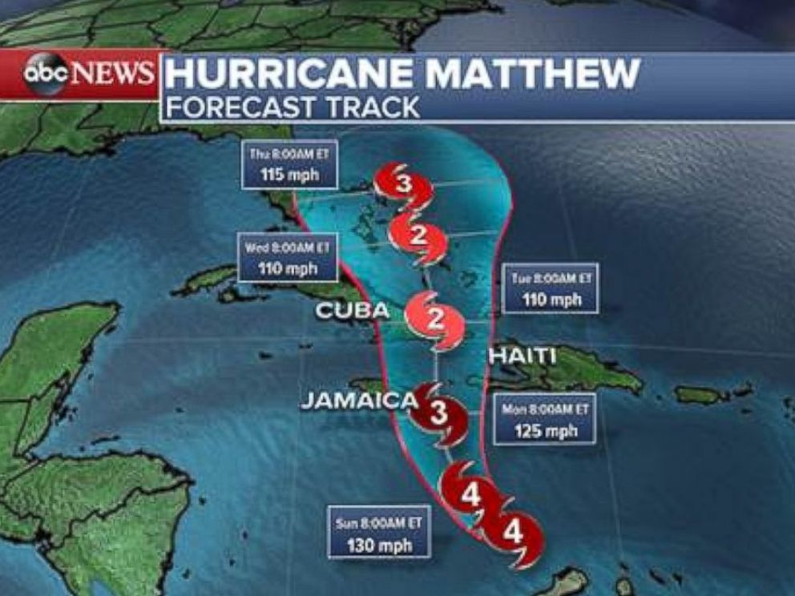
Collapsed structure
Matthew -Thirteen Group

Slide 11

Test of opinion – Cobalt Housing Newsletters
www.cobalthousing.org.uk/files/2016/08/Newsletter-Keeping-It-Local-Issue-1.pdf
https://www.cobalthousing.org.uk/files/2016/09/PS157327-Keeping-It-Local-Issue-SINGLE-PAGES.pdf

Slide 12

Devolved Government
– the scrutiny challenge
Combined authorities - Early days
How will local people be encouraged to be heard?
How will local people feel less distant from decisions?
How will they hold a regional Mayor to account?
How do we stop this being a tick box exercise?
Where is the best place for scrutiny?
Devo how, devo why?
Cards on the table
http://www.cfps.org.uk/devolution

Slide 13


Any questions/comments
Yvonne@tenantadvisor.net
www.tenantadvisor.net
07867974659

Slide 14



On the couch
What are your tenants reviewing and scrutinising?
Can your panels be more digital?
Inceptives for involvement
Induction programmes for tenants

Slide 15
What else?
23rd November 2016
Comprehensive Spending Review – Newsletter
6th December 2016
NHC 6th National Scrutiny Conference - Leeds
24th January 2017
Scrutiny.Net Wulvern, Crewe
Future speaker ideas?

Slide 16

Thanks – have a safe journey home
Telephone and e mail advice is free – anytime
You get a free half days training for a tenant group for members
Is your web page and your good stuff on the site up to date?
Yvonne@tenantadvisor.net
www.tenantadvisor.net
07867974659

