Slide 1
Office of Civil Society
Policy Overview 2017
Paul Schofield
paul.schofield@culture.gov.uk
Notes:
Office of Civil Society – responsible for developing policies and delivering Government programmes to further the impact of civil society.
We are in process of moving from the Cabinet Office to DCMS. This will lead to a better alignment of activities and increased opportunities to work with the sector in arts culture and sport.
Rob Wilson still Minister for Youth, as well as Civil Society ( and Libraries!)
Broad priorities the same, harnessing the powers of the voluntary sector to deliver social reform and build a society that works for everyone

Slide 2
Supporting philanthropy, volunteering, community and business social action and social investment
Growing youth social action supporting youth provision
Enabling a more self-sustaining voluntary, community and social enterprise (VCSE) sector
Our outcomes
Notes:
OCSI role is to help grow a Bigger and Stronger Society
Our high level outcomes are:
Supporting philanthropy, volunteering, community and business social action and social investment
Enabling a more self-sustaining voluntary, community and social enterprise sector
Promoting NCS and youth social action
Where possible our work focuses directly one the wider priorities of Government – Health and Social Care reform, housing, troubled families) and supporting other government departments develop and test new models

Slide 3
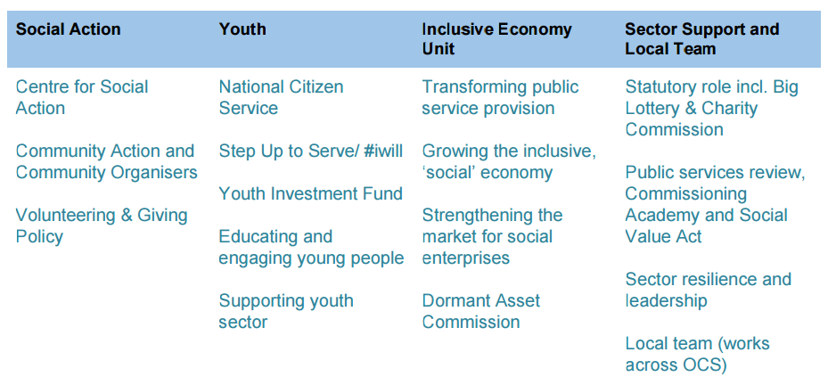
Office of Civil Society

Slide 4
Youth Policy
The first match funders we are working with are:
Supporting activity within education, health and social carehttp://www.pearsfoundation.org.uk/partner/the-iwill-fund
UK Community Foundations will create small grants for local social action opportunities through their network of 43 Community Foundations across England. http://www.ukcommunityfoundations.org/our-programmes/youth-social-action
Comic Relief will develop opportunities for young people from areas and backgrounds currently least likely to participatehttps://www.comicrelief.com/news/comic-relief-announces-partnership-to-support-iwill-campaign
Sport England joined the #iwill Fund with a £3 million partnership in March 2017. They will support projects which create opportunities for 10-20 year-olds to use sport as a way to do ‘social actionhttps://www.sportengland.org/funding/funding-for-volunteering/potentials-fund/

Slide 5
Youth Investment Fund
£40m across 6 areas
Announcements made in May

Slide 6
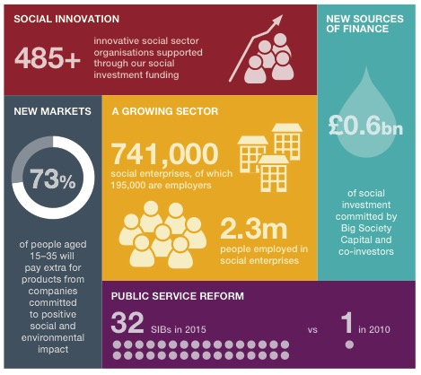
Social Finance and Investment
Notes:
Since the 2015 election, the Government has:
Launched the Access Fund or Foundation for Social Investment. This will have £100m of new money to support social investment. Access comprises two sets of funds – the Growth Fund (which is already up and running) which combines funding from Big Lottery Fund, Big Society Capital and Big Society Trust to fund organisations to make small loans to charities and social enterprises; and the Capacity Building Fund (not yet launched) which will fund organisations to run grant and support programmes for charities and social enterprises
We have also committed to further Social Impact Bonds or SIBs. In the Spending review, Cabinet Office secured £105m to expand Social Impact Bonds over the lifetime of the Parliament. Of this, £80m will be used to catalyse more locally based SIBs through a Life Chances Fund, at least £5m will support rough sleepers with complex needs; and £20m will support people with mental health problems into employment.
Expressions of interest for the Life Chances Fund are currently being invited from Local Authority Commissioners to develop SIBs relating to Drug and Alcohol Dependency, and Children’s Services. The deadline is 30 September.
To compliment the Life Chances Fund, the Cabinet Office has developed in partnership with Oxford university, the Government Outcomes LAB. This will provide practical, on the ground support to commissioners as well as developing world leading research in this field.

