Slide 1
GDPR what do we need to do?
Clare sanderson
Ig solutions liverpool ltd
Mobile: 0(044)774 779 5596
Office: 0(044)151 428 1822
clare.sanderson@igs-l.co.uk

Slide 2




What is GDPR?
……..The thing that no-one finds exciting
……..The thing that is someone else’s responsibility
……..The thing that IT are responsible for

Slide 3
Who am I?
I was the Executive Director of Information Governance at the NHS Information Centre now NHS Digital from 2007 to December 2013……..
A member of
  CQCs National Information Governance Committee
  UK Council of Caldicott Guardians
  DH hosted National IG Advisory Group
I am a member of the Confidentiality Advisory Group (Chair Team)
Since January 2014 I have been providing Independent Consultancy on Information Governance, Privacy and Confidentiality
Notes:
I AM an expert in data protection
I AM an expert in health and social care
I AM NOT an expert in housing!

Slide 4



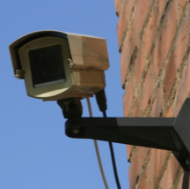
Personal Data
…data which relate to a living individual who can be identified –
(a) from those data, or
(b) from those data and other information which is in the possession of, or is likely to come into the possession of, the data controller
Notes:
Data protection law applies when housing associations, as data controllers are processing personal data.
What is personal data?
See slide. It includes tenant and staff records, as well as information held and used about previous tenants. CCTV images, website photos and information, housing apps, etc. Paper-based and digital.
“Processing” refers to anything a housing association does with personal data – collecting, using, analysing, sharing, and disposal

Slide 5
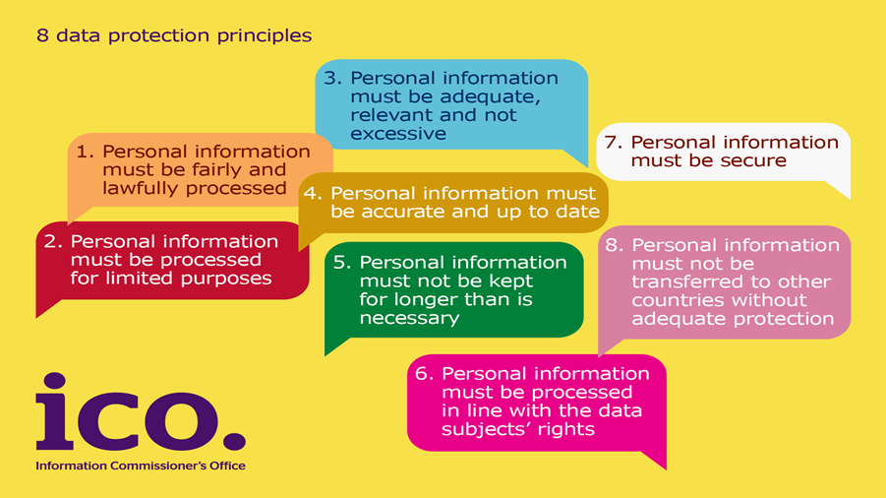
The Data Protection Act 1998
Notes:
Current DP law – the DPA 98. It applies when data controllers are processing PD.
You are effectively the data controller (technically it’s the governing body), therefore the association is responsible for data protection compliance. (Even when you use data processors, shredding companies or cloud IT providers – they are your data processors and you are still responsible.)
Brief summary of principles
1 – Fair and lawful
Comply with other laws
Cause no unwarranted detrimental effects on people
Only do with people’s data what they would reasonably expect you to
Be transparent – inform people what you are doing with their data
2 – Limited and specified purposes
Be clear for what purpose you collect, hold and use people’s data – and don’t use for other unrelated purposes
3, 4, 5 – data quality principles
Adequate, relevant, not excessive – enough for what you need the data for, but no more
Accurate and up to date
Kept no longer that is necessary – have a appropriate retention policy in place, and stick to it
6 – processed in line with data subjects’ rights
E.g. subject access rights –
7 – Secure
Actually the requirement is to have appropriate measures in place to secure the data
Includes having appropriate agreements with data processors
8 – Transfers outside the EEA
OK as long as adequate protection is in place

Slide 6


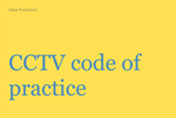
https://ico.org.uk/
Notes:
Loads of advice on ico website and these are being updated to reflect the new GDPR requirements

Slide 7
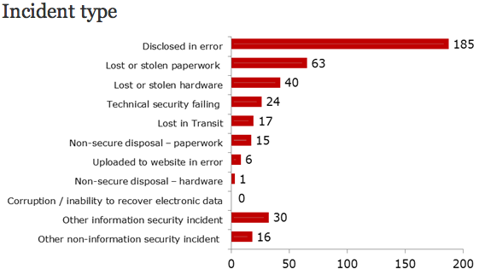
What could possibly go wrong?
Notes:
So how does a DC fails to comply with the principles?
what happens if they do…..

Slide 8
ICO data protection enforcement
£500,000
Notes:
So what happens if a DC fails to comply with the principles?
Currently, the ICO has a range of enforcement tools available to use when a data controller fails to comply with the DPA:
- offer advice, no further action taken
Enforcement tools available:
- agree an undertaking
- issue an enforcement notice
- issue a civil monetary penalty of up to £500,000

