Slide 1
Clare – steps to GDPR prep

Slide 2
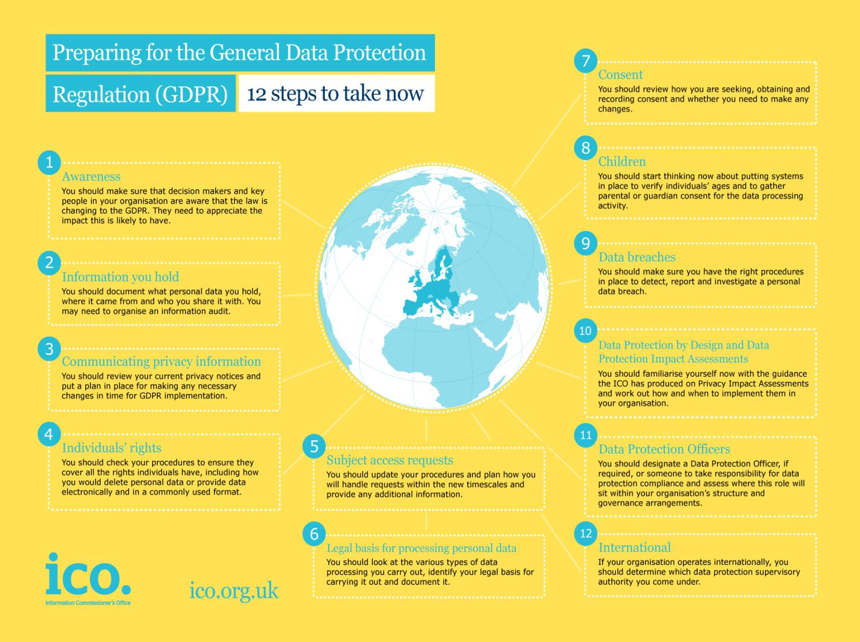
Notes:
As a starting point, the ICO has developed 12 steps to take now – for organisations to make a start in planning how they’re going to comply by May 2018.
You’ll need to check them all, but a few highlights include:
Privacy notices - Under the GDPR there are some additional things you will have to tell people. For example, you will need to explain your legal basis for processing the data, your data retention periods and that individuals have a right to complain to the ICO if they think there is a problem with the way you are handling their data. Note that the GDPR requires the information to be provided in concise, easy to understand and clear language.
The ICO’s Privacy notices code of practice was revised a couple of months ago and now reflects the new requirements of the GDPR. Make sure you read it and make the changes you need to.
Individual rights - The main rights for individuals under the GDPR will be:
• subject access
• to have inaccuracies corrected,
• to have information erased,
• to prevent direct marketing,
• to prevent automated decision-making and profiling, and
• data portability.
You’re likely to come across some, if not all, of these in schools so you’ll need to know what your obligations are so you can properly deal with any requests you receive.
SARs - The rules for dealing with subject access requests will change under the GDPR. In most cases you will not be able to charge for complying with a request and normally you will have just a month to comply, rather than the current 40 days. There will be different grounds for refusing to comply with subject access request – manifestly unfounded or excessive requests can be charged for or refused. If you want to refuse a request, you will need to have policies and procedures in place to demonstrate why the request meets these criteria.
Consent – if you process any personal data on the basis of consent, you’ll have to review how you are seeking, obtaining and recording consent and whether you need to make any changes. Consent must be freely given, specific, informed and unambiguous, and a positive affirmation of the individual’s agreement. That’s a high standard. This will likely be relevant for any contact preferences you may have set up with parents and alumni, perhaps for school fundraising purposes.
Children - You should start thinking now about whether you will need to gather parental or guardian consent for the data processing you carry out. For the first time, the GDPR will bring in special protection for children’s personal data, particularly (ONLY) in the context of commercial internet services such as social networking. If you arrange for children in your school to sign up for apps in the classroom, or for homework, you’ll need to think about how consent can be obtained.
Data breaches - You should make sure you have the right procedures in place to detect, report and investigate a personal data breach – for example if you lose some personal data or disclose data to the wrong recipient. The GDPR will bring in a breach notification duty for all organisations. Not all breaches will have to be notified to the ICO – only ones where the individual is likely to suffer some form of damage, such as through identity theft or a confidentiality breach. If you do need to report it you’ll have to do it within 72 hours of the breach being discovered.
You should start now to make sure you have the right procedures in place to detect, report and investigate a personal data breach.
Data Protection by Design and Data Protection Impact Assessments – When your school is considering using data in new and innovative ways, or considering implementing new technology to monitor pupils in some way, it’s currently good practice to carry out a privacy impact assessment. This will become a legal requirement in some circumstances under the GDPR. You should familiarise yourself now with the guidance the ICO has produced on Privacy Impact Assessments (PIAs) and work out how to implement them in your organisation. You should start to assess the situations where it will be necessary to conduct a DPIA.
It has always been good practice to adopt a privacy by design approach and the ICO has recommended organisations use privacy impact assessments for some time now. However the GDPR will make this a legal requirement for some projects.
Data Protection Officers – Public authorities (bodies) are required to appoint a DPO. It is unclear at this stage whether the definition of ‘public authority/body’ under GDPR will mirror that used under the DPA. However it seems unlikely that it will depart from it significantly; therefore organisations that are currently caught by FOISA ought to prepare for GDPR on the assumption they will be caught not only by GDPR (which they most certainly will) but also by the obligations specific to GDPR’s public authorities and public bodies.
You will need to identify someone to take responsibility for data protection compliance and assess where this role will sit within your organisation’s structure and governance arrangements. The GDPR will require some organisations to designate a Data Protection Officer – all public authorities must so housing associations will require one.

