Slide 1


DCLG Consultation
Recognising resident associations and their power to request information about tenants
Scrutiny. Net Officers Meeting - 3rd October 2017
Yvonne Davies
Notes:
What is a tenants’ association?
A tenants’ association is a group of tenants (including and usually leaseholders) who hold similar occupancy agreements from the same landlord that include provisions for the payment of variable service charges. Collectively an association represents the view of its members.
A tenants’ association is most effective when it is a “recognised tenants’ association” in accordance with Section 29 of the Act. Broadly speaking, this requires an association of tenants who, under the terms of their lease, need to contribute to the same costs through a service charge (“qualifying tenants”), with or without other tenants, which is formally recognised either by a landlord-issued notice or a certificate of the First-tier Tribunal (Property Chamber) (“Tribunal”).
Formally “recognised” tenants’ associations have rights alongside tenants regarding:
Information on service-charge costs;
Information on insurance;
Consultation under Section 20 of the Act; and
Consultation on the appointment of a managing agent.
These rights are additional to some rights not afforded to individual tenants, such as the right to appoint a surveyor to advise on service charges.
Typically, Tenants’ associations in a block of flats need at least 60% of “qualifying tenants” to join for landlord or Tribunal recognition.
The proposals
The proposed regulations seek to improve the prospects for formal recognition of an association by making it easier for secretaries of tenants’ associations to obtain contact details for other “qualifying tenants”. Under the proposals, landlords will need to ask all such “qualifying tenants” for their consent to pass their contact details onto a tenants’ association when an association’s secretary is seeking formal recognition under Section 29 of the Act.
The consultation includes a prescribed form for landlords for this purpose. Landlords will need to ensure that any tenant consent is obtained in a way that complies with the Data Protection Act 1998 and the General Data Protection Regulation, which comes into force in May 2018 – as drafted, we do not think the form is sufficient for this purpose.
Landlords will need to make it clear to associations’ seeking tenant contact information must only use it for the specific purpose of the association’s secretary carry out their role and not for any other purpose.
Landlords will be required to provide the association’s secretary with the contact information of all consenting “qualifying tenants” and the number of “qualifying tenants” within 30 working days of the initial request.
We anticipate that the regulations will include a mechanism allowing landlords to charge “other parties” its costs of complying with the regulations. The consultation invites responses on how to circulate the costs and who should be responsible for paying them, in addition to responses on the processes and timings of the proposed regulations.
Responding to the consultation
The Government has invited views of all parties with an interest in residential housing to consider the consultation document and then complete an online survey or send written responses by post or email. The consultation period closes on 19 September 2017.
In the wake of Grenfell Tower, it is clear that engagement with residents and resident groups is a key priority for the Government. It, therefore, seems inevitable that residents will more frequently seek to form formally recognised tenants’ associations, placing additional administrative burdens on landlords.

Slide 2

What is it?
Secondary legislation – S29A Landlord and Tenant Act
New power in S130 of the Housing and Planning Act 2016
Imposes duties on landlords to provide the secretary of the residents association with information about tenants
Make it easier for secretary of a TARA to obtain contact information on leaseholders (thereby being formally recognised)

Slide 3

Why would they (1)?
Qualifying tenants (leaseholders) have the right to form a recognised TA
Applications in writing to recognition – landlord from the TARA secretary OR application to the First Tier Tribunal (Property Chamber)
Recognised TA has additional rights to a leaseholder – they can appoint a surveyor to advise on any matter relating to service charges payable to the landlord
The surveyor can appoint assistants, inspect and copy relevant documents held by the landlord and inspect common parts of the leasehold property
Notes:
Property Chamber – HM courts and tribunal services – settle disputes involving leaseholders and private rented homes

Slide 4
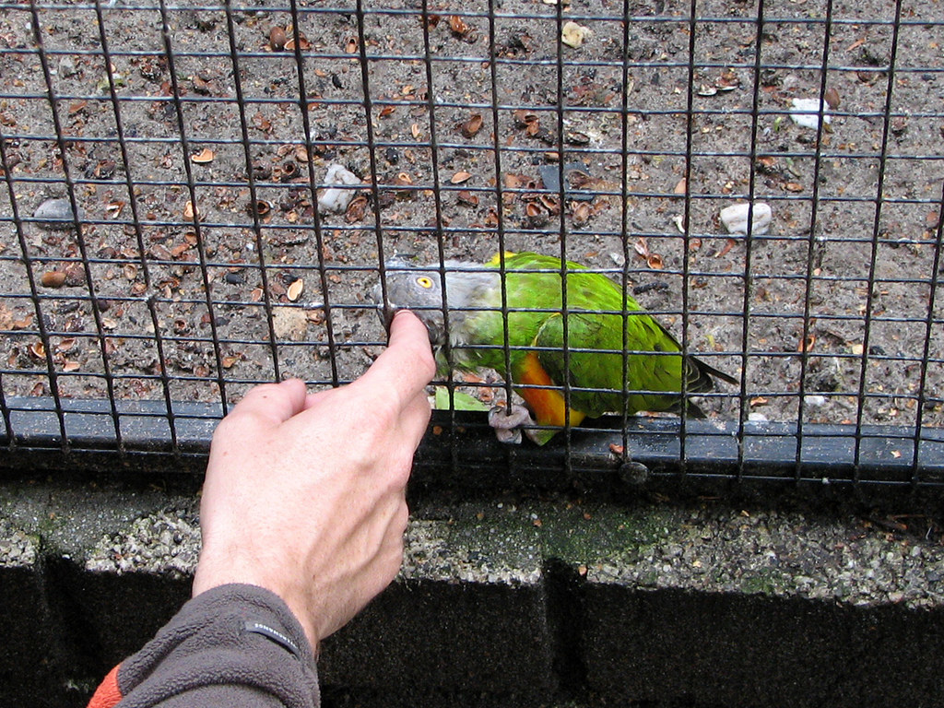
Why would they (2)?
Recognised TA can exercise other rights (also available to individual leaseholders), including:
  Asking for a summary of service costs
  Inspecting service accounts and receipts
  Ask for consultation on appointment/reappointment of managing agent
  Ask for summary of insurance cover
Some leaseholders are absent – so mailshots don’t work – DCLG is making it easier for TAs to contact absent landlords

Slide 5

Existing to New
Currently 60% of leaseholders may be required to form a TA (Court discretion)
It is proposed to drop this figure
Landlord would now( if requested by the TA) have to seek consent to provide the following information (within 5 days):
  Name of those who get the service charge payment request
  Correspondence address
  E mail address
Landlord must provide the information to the secretary within 30 days and the detail/number of non-consents
To meet DPA requirements – consent means being very clear of the specific and express purpose of the use/share of data
Landlord can recover costs – by flat fee, or a sliding scale of charges, dependant on the number of leaseholders
Court has the power to remedy failure by landlords to comply

Slide 6

Discussion
Do we need to do anything about this in tenant involvement?
If so – what?
What is good engagement with leaseholders?
Yvonne Davies
Scrutiny & Empowerment Partners Limited
yvonne@tenantadvisor.net
www.tenantadvisor.net
07867973659

