Slide 1
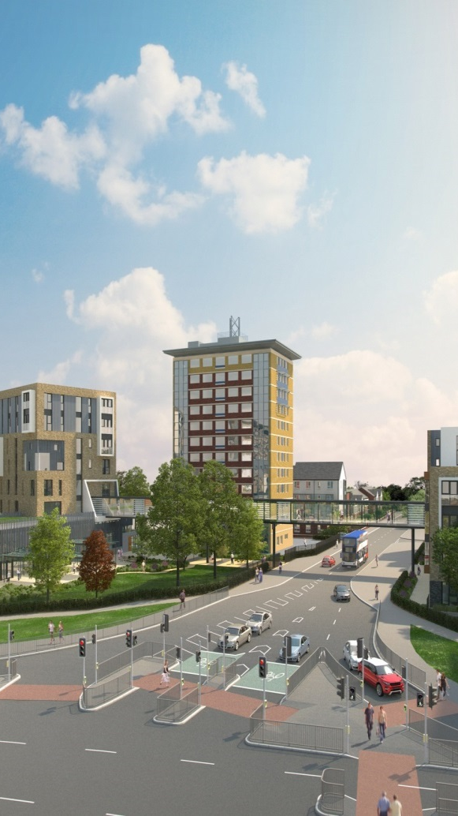
Tenant Involvement at WCHG
Dean Slavin, Resident Involvement Manager
Tuesday 3rd October 2017

Slide 2
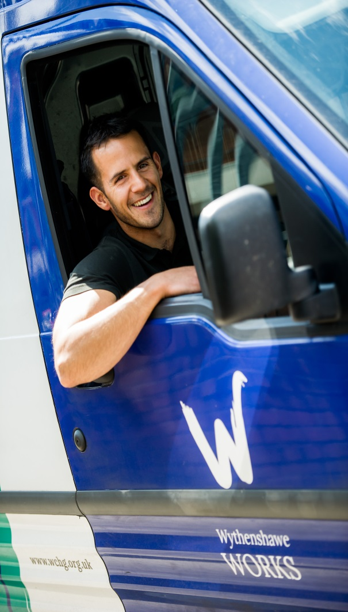
This session will cover:
WCHG – Who are we
Involvement story
Our Manchester
Real Benchill
Strategy Journey 2016
Involvement Strategy and structure
New approach to TARAs
Everyday Voice
Service area champions
Any questions

Slide 3
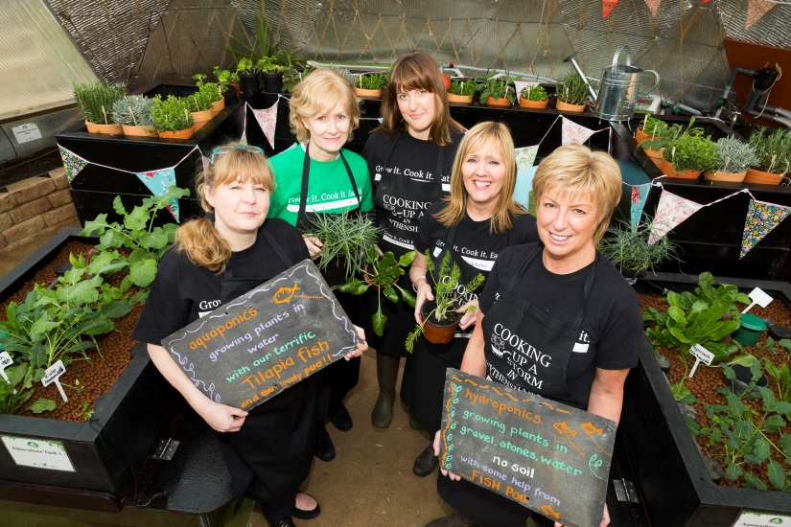
Wythenshawe Community Housing Group
Based in Manchester
Formed in 2013
13,500 socially rented homes
Manages most of Wythenshawe
2 Subsidiaries
New Garden City Homes Brand
Recently built and opened V135
Large Community Investment Focus

Slide 4
Background to Involvement
Consultation began in 2012
30 residents shaping new structure
“Best of both worlds” approach
Tenant designed structure
1st service to be “Group Wide”

Slide 5
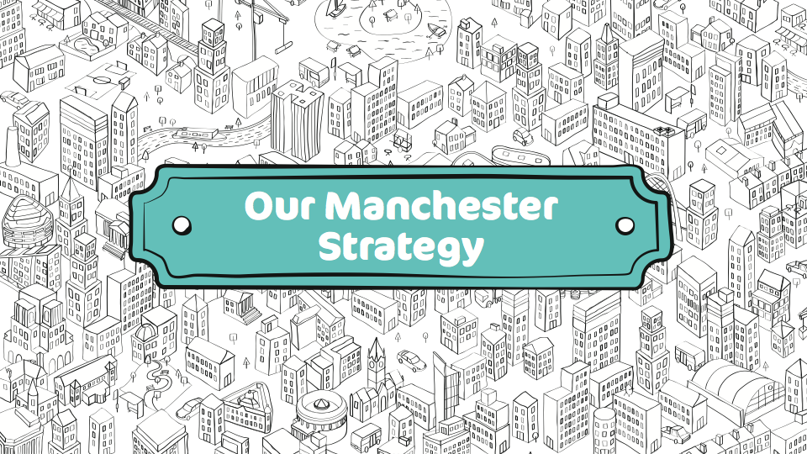
Notes:
What

Slide 6
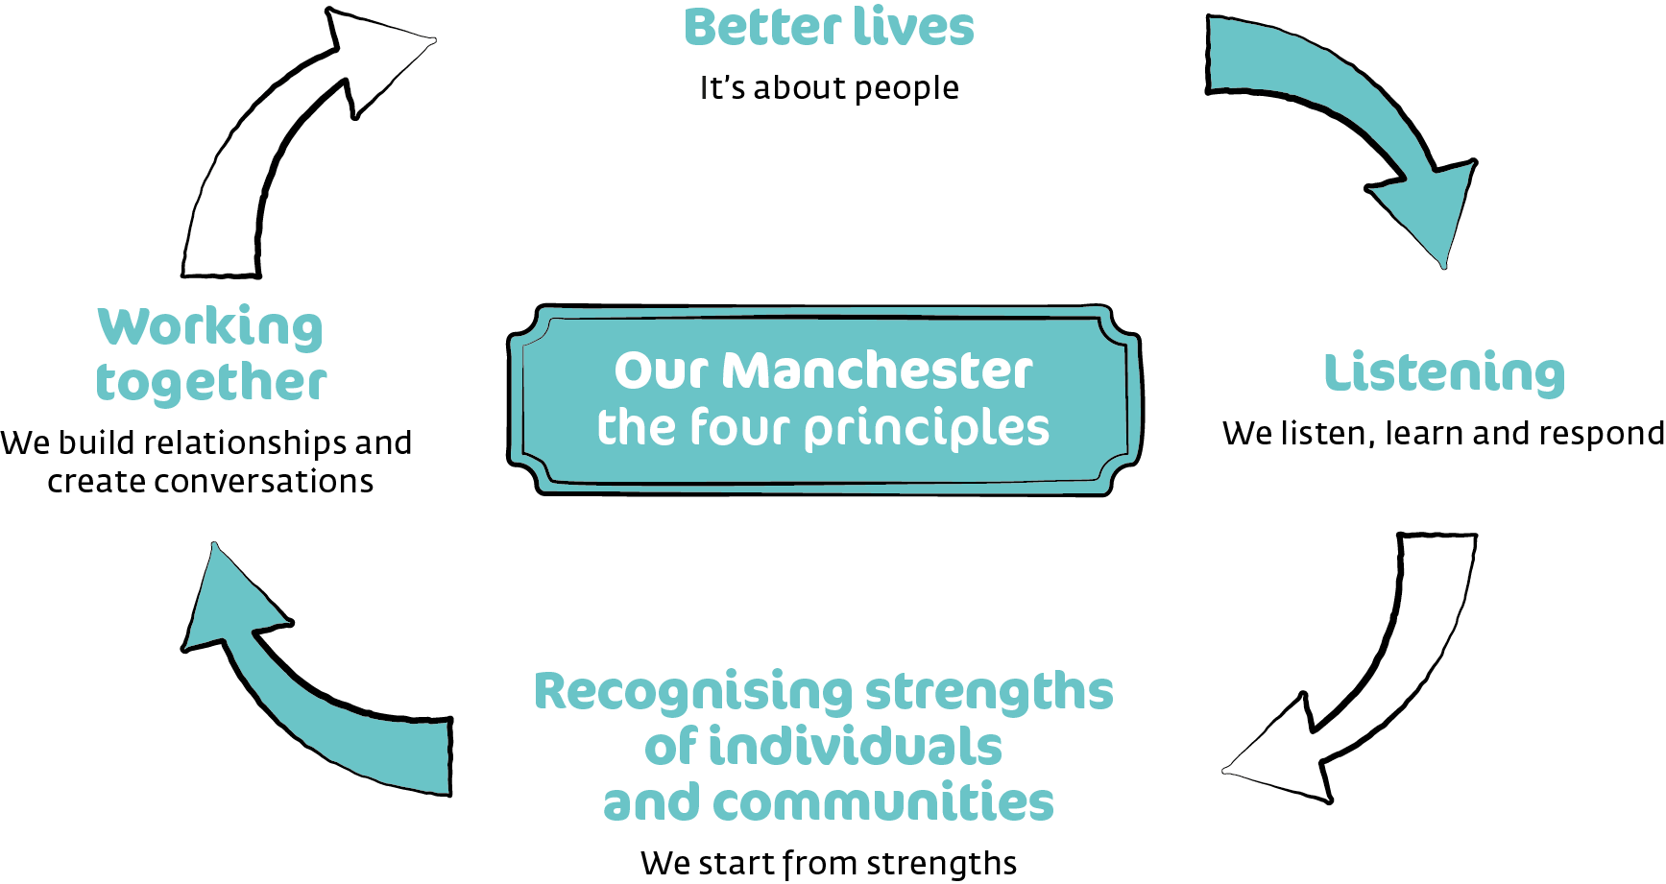

Slide 7

Our Manchester Film https://youtu.be/i-Q3akCMQBo

Slide 8

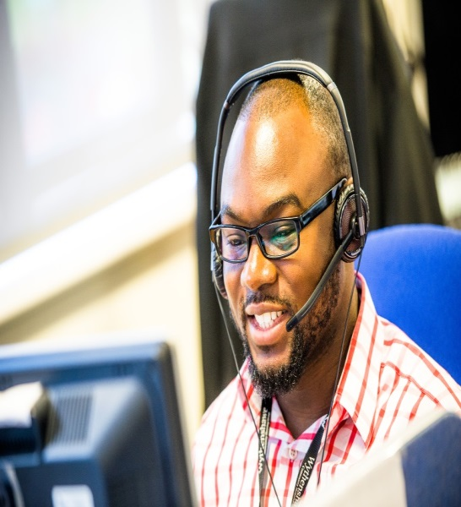
What is integrated neighbourhood management?
More efficient way of local services (Police, Housing, Fire, NHS, Early Help, Social Services) working together in a neighbourhood
Greater role for residents and local organisations in setting outcomes and coming up with own solutions
Based on Our Manchester strengths-based approach – Place Based Integration and Public Service Reform
Long term aim is to improve outcomes for residents and to reduce need for local services

Slide 9
Why Benchill?
Builds on Real Life's Campaign – Real Neighbourhoods
Strong community
Strong partnerships
Community assets
Some challenges…..

Slide 10

Who took part?
50 volunteers (GMP, WCHG, Fire, MCC, residents)
302 conversations on the doorstep
102 residents attending clubs
4 local community groups
TOTAL:
404 people living in Benchill
More than 20% of Benchill households

Slide 11
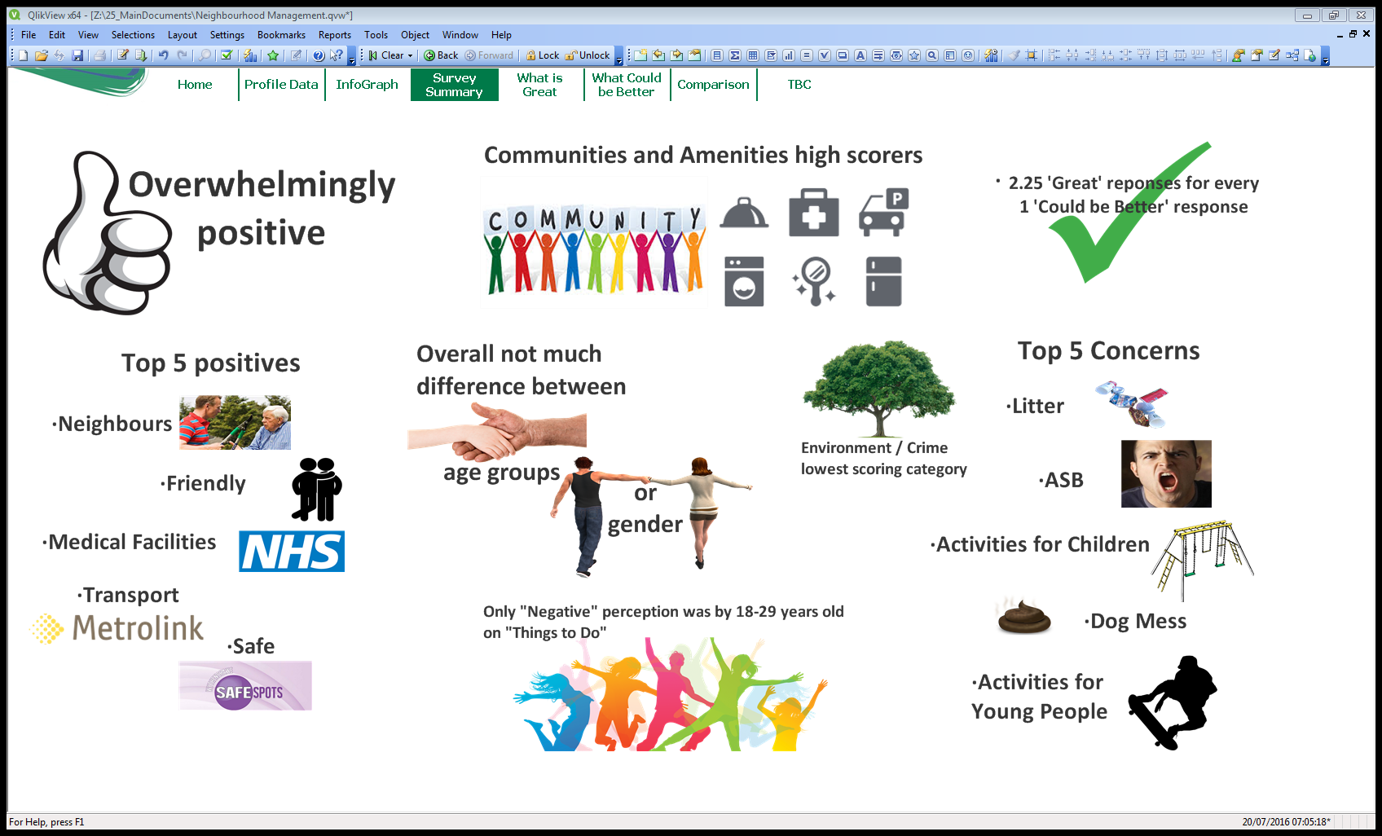

Slide 12
REAL BENCHILL VIDEO

Slide 13
Strategy Journey
Began 1st April 2016 at Trafford Hall
Over 100 tenants directly involved
Good practice research
Staff and tenant steering groups
New structure designed
New involvement introduced
Launched at Tenant Conference
Modern approach being designed and implemented right now
Play Video

Slide 14
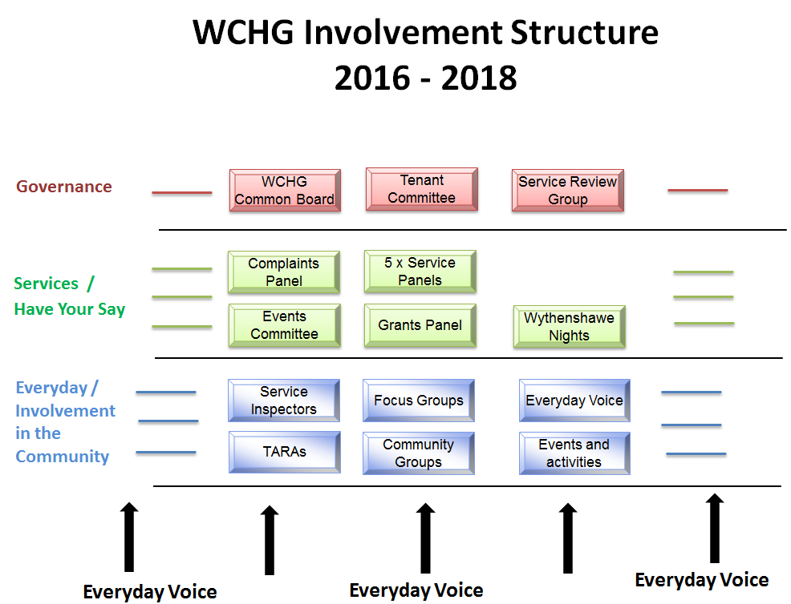
Proposed Structure

Slide 15
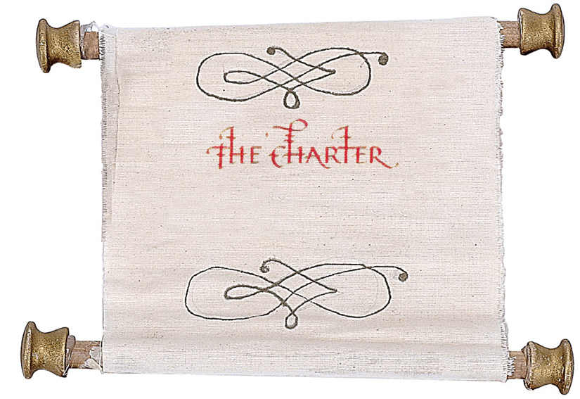

Slide 16
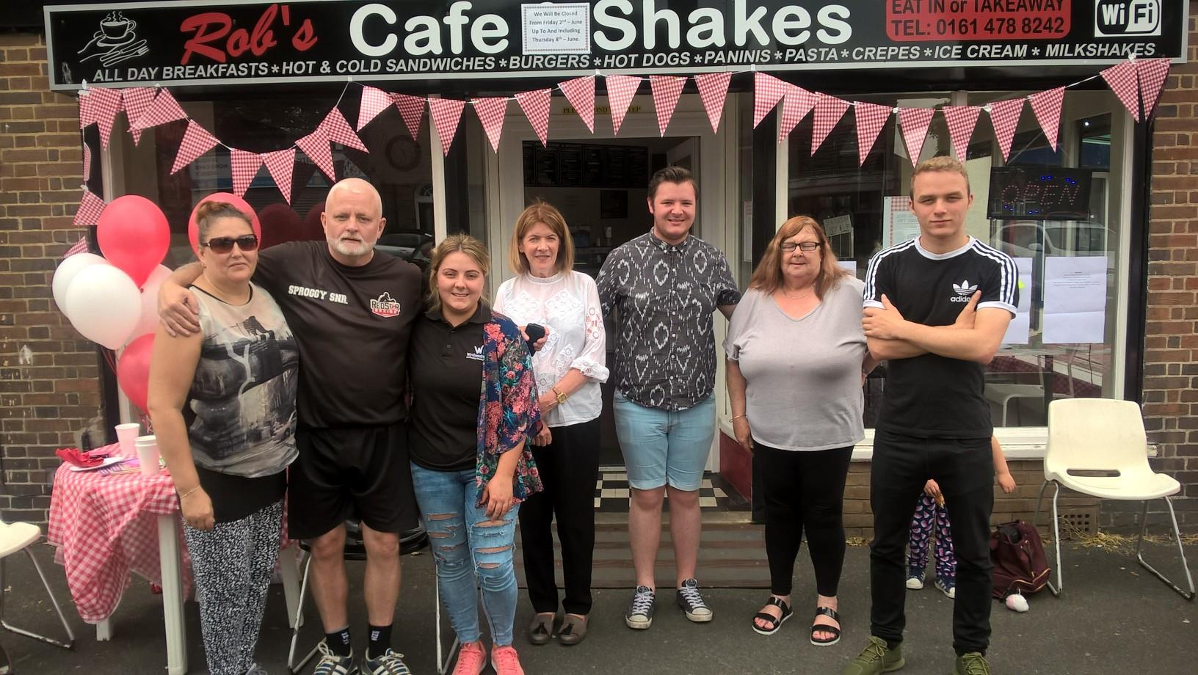
Case Study – Northern Moor TARA
Replacing a long standing TARA
Conceptual stage but 100% newly involved
Diverse mix of residents
Engaging in a different way
New priorities and offers for the community

Slide 17
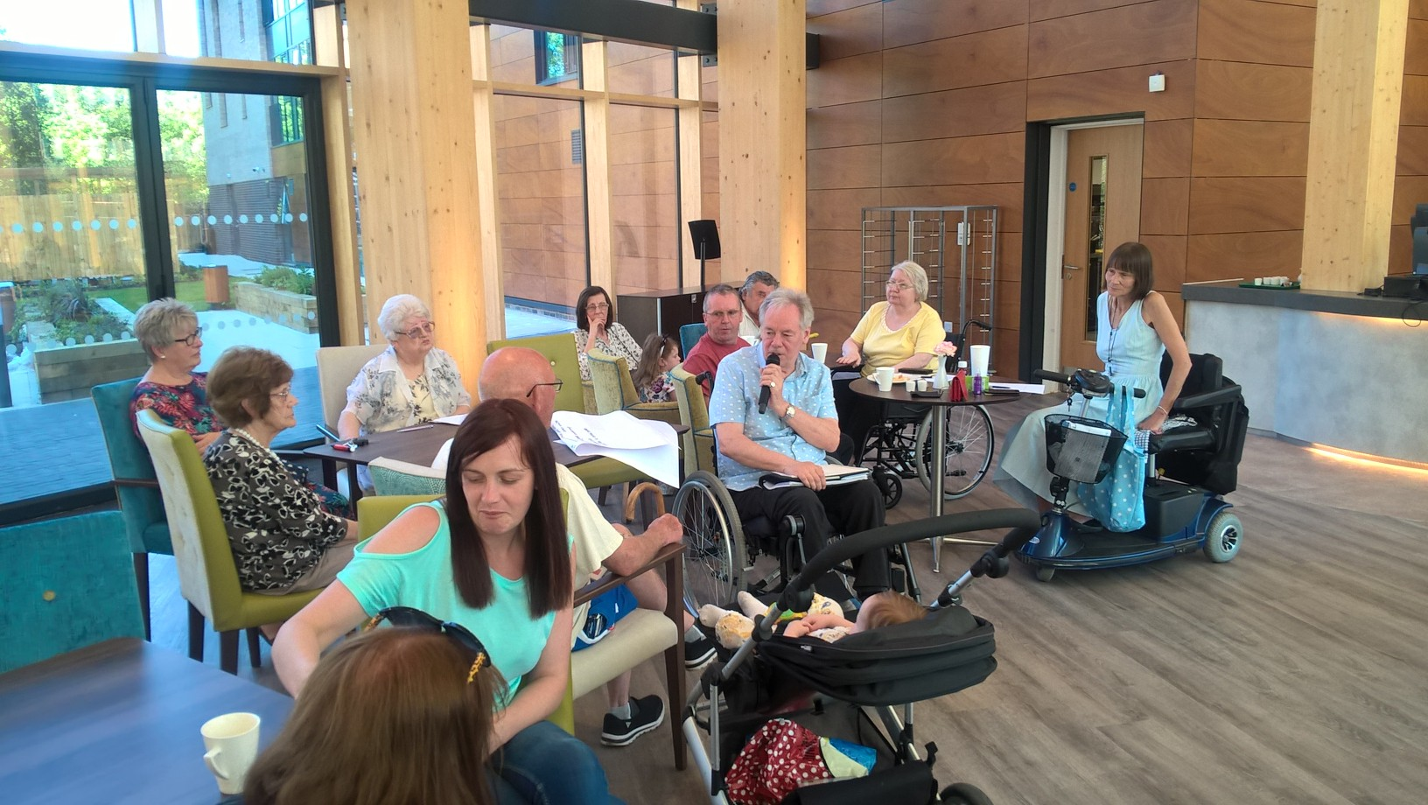
Case Study – Village 135
Informal residents meeting
Setting up activities at V135
Integral to Cladding Consultation
Working with Real Food.

Slide 18


Slide 19
What is Everyday Voice?
Street Reps
TARAs
Inspectors
Walkabouts
Social Media
Events

Slide 20
Everyday Voice Successes
External high rise improvements
Designing out crime
Increased fobs at V135
Removal of rubbish and fly tipping hotspots
Etc, etc, etc…

Slide 21



Slide 22
Going forward….
2 TPAS Awards!
Continue to refine new mechanisms
Impact Statement end of calendar year
Work with MHPP
Click to Play Video

Slide 23


