Slide 1
Gaining Customer Insight
Laura Carmody, Head of Insight and Product Development
www.hact.org.uk

Slide 2
Who Am I? Who are HACT?
Dr Laura Carmody – Head of Insight and Product Development at HACT.
Joined HACT in July 2017; Prior to this – Performance and Information Business Analyst at East Thames (now part of L&Q)
Prior to that I was a teacher and a geologist
AND HACT…
Originally set up in the 1960s to help set up housing associations but rebranded in 2012 as the Ideas and Innovation agency for housing.
We now focus on driving innovation in the housing sector and supply chain.
Projects cover 5 workstreams; Value, Local, Insight, Health and Digital.
Notes:
Value – social value consultancy, which can be certification, training on social value and its use, creating new values for the UK SVB.
Local – community investment strategies and housing associations delivering sport and physical activity
Insight – RnD for HACT. Community Investment and the bottom line; service delivery evaluations; building evidence in the housing sector; the Insight tools
Health – brokering relationships between NHS and HAs; service delivery evaluations
Digital – digital strategy and assessment of maturity; Launchpad for tech innovations;

Slide 3
Current HACT projects looking at gaining Insight
Resident Satisfaction
Looking at changing the way we look at resident satisfaction
Key drivers and actionable insights
Not just focussing on your dissatisfied residents
Resident feedback from focus groups
Personas/segmentation of resident feedback
Report launch Late Feb/Early March
Random Control Trials
HACT has worked a lot on standards of evidence
RCTs are great way of generating evidence about what works
Employability and health interventions
Evidence launch – 1st round April 2018, 2nd round end of 2018

Slide 4
Community Insight and Value Insight

Slide 5
New data on Community Insight

Slide 6
Insight Tools
One way that HACT have curated help for housing providers to gain further Insight is through Community Insight and partner products.
https://www.campaigntoendloneliness.org/wp-content/uploads/The-Missing-Million-report-FINAL.pdf

Slide 7
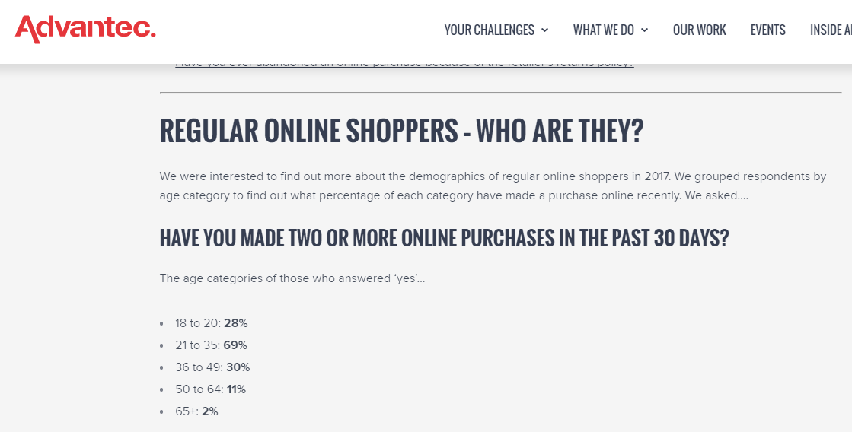
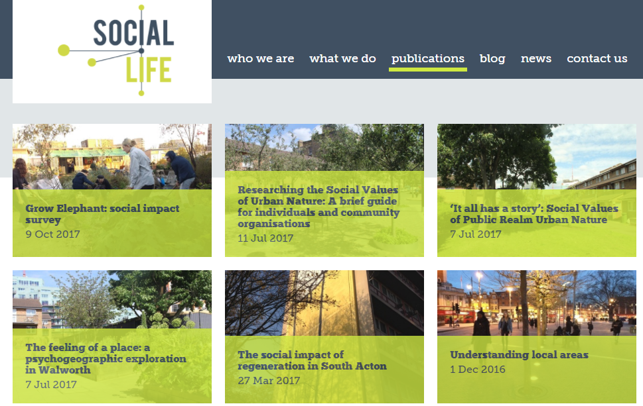
Other sources of Data for Insight
https://www.peabody.org.uk/media/2394/21st-century-peabody-report.pdf
https://advantec.co.uk/ecommerce-consumer-behaviour-survey-2017/
https://www.nesta.org.uk/
http://www.social-life.co/publication/

Slide 8
Other sources of Data for Insight
To find out about more open data sources, some of which are already in Community Insight, but others are not possible to visualise in CI, have a look at this blog and the related links.
https://github.com/theodi/shared/wiki/Finding-Open-Data?

Slide 9
Thank you
Laura Carmody
Laura.carmody@hact.org.uk
www.hact.org.uk
020 7250 8500
49-51 East Rd, London

