Slide 1
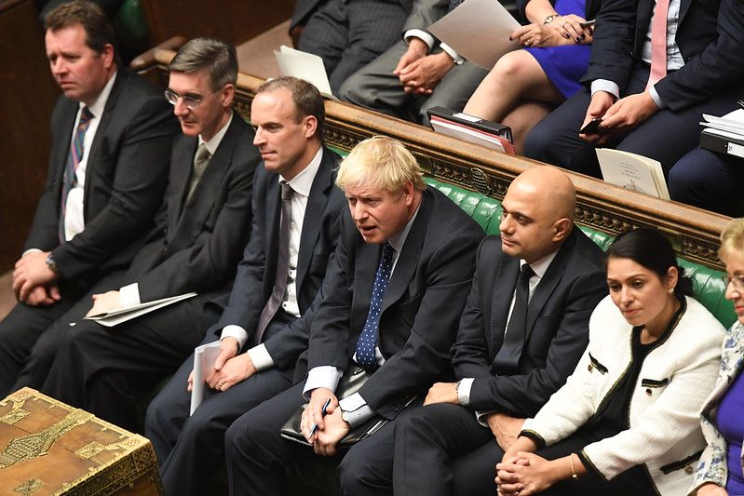
The Conservative Manifesto (Housing)
S.Net, 22nd January 2020
Yvonne Davies
Scrutiny and Empowerment Partners Limited
07867974659

Slide 2
Manifesto and costings
https://vote.conservatives.com/our-plan
Supporting communities
Help to buy and rent
Delivering the housing people need
Places people want to live

Slide 3
Supporting Communities
Enable councils to deliver essential local service
Local people having a say on local Council tax, but LAs can make a case to raise more
Devolving power to people and places across the uk – an English devolutions white paper – local mayors and police/crime commissioners
City and Growth deals
Northern Powerhouse : drive further levels of foreign investment and roll out to the rest of England
Whitehall does not know best – power to towns, cities and communities and investment to unleash growth

Slide 4
Help to buy and rent
Young people getting on the housing ladder (3 million) - a new market for long terms fixed rate mortgages and clash the cost of housing deposits
More homes to local families, through S106/equivalent.
Discount homes for local people – esp. key workers
Maintain commitment to the RTB, including for HAs following a successful WM pilot?
Help to buy extended from 2021 to 2023
Simplify shared ownership products – single standard for all HAs to end confusion and disparity
Reform leasehold, including a ban on new leasehold homes, restriction of ground rents to peppercorn and mechanisms of redress
Better deal for renters – abolish no fault evictions, one lifetime deposit, protection from revenge evictions from rogue landlords, strengthen rights of possession for good landlords

Slide 5
Delivering the housing people need
Context
Home ownership is a fundamental conservative value
People happier and more routed in communities if they own their home
Enables the home to be passed on to future generations
Promises
Enable access to home ownership for YP to have a stake in society
Increase the number of homes built
Dignity and respect for those in social housing – social housing white paper
Empower tenants and support the continued supply of social homes
Measures for better redress, better regulation and improve the quality of social housing
Renew the affordable homes programme – to deliver hundreds and thousand of affordable homes
Homeless prevention and an end to the blight of rough sleeping by the end of the next parliament through rough sleeping initiatives and Housing First (expand pilots) and bring together local services to meet needs on health and housing of people on the streets
Pay for all this by a surcharge on stamp duty on non uk resident buyers

Slide 6
Places people want to live
1m homes delivered – but its not enough
300,000 homes target by the mid 2020’s – another 1m homes of different tenures in areas that really need them
Simpler planning system for the public and small housebuilders
Infrastructure first – roads and schools and a new £10billion Single Housing Infrastructure Fund
Community engagement in choosing their local design standard – a greater say in style and design with LAs
Building Safety: following Grenfell – implement recommendations and the first phase of the inquiry recommendations
Support High Rise residents with the removal of unsafe cladding and continue materials testing
Community Housing and Self Build – help to find land and use the help to buy scheme, including resident control of land and buildings (TMOs)
Env friendly Homes – support low energy bill and set env targets, all new streets to have trees
Homes for the future – encourage innovative design and technology to make homes more accessible and suitable for disabled people and an aging population
Protect and enhance the Green Belt – improve poor quality land, increase biodiversity, make the countryside more accessible for local community use. Prioritise regeneration of brownfield sites

Slide 7
Questions/discussion What does this mean for us?

