Slide 1
Customer Scrutiny
and GDPR
Customer Engagement Team
January 2021

Slide 2
Customer Scrutiny & GDPR
Background
The Problem
Due to Covid 19 measures, Customer Scrutiny Inspectors (CSI) were unable to speak to YHG residents, face to face in a physical environment.
YHG put further internal controls in place restricting non-essential meetings from taking place in offices across the business. Restriction grew tighter over the following months as tiers and the National lockdown was introduced
With offices closed, CSI had no access to YHG’s customer data, resources or direct support.
CSI were therefore unable to gather evidence necessary to undertake a customer scrutiny through traditional and established means.
Our Options
Wait until restrictions are lifted to allow either CSI to undertake evidence gathering as has been done previously.
Undertake a scrutiny based around digital only engagement, such as via survey monkey to gather customer views.
Conduct internal reviews of policy and procedures or self-appraisals on previous reviews to keep CSI active.
Empower and support CSI to safely and securely gather evidence from their own homes.

Slide 3
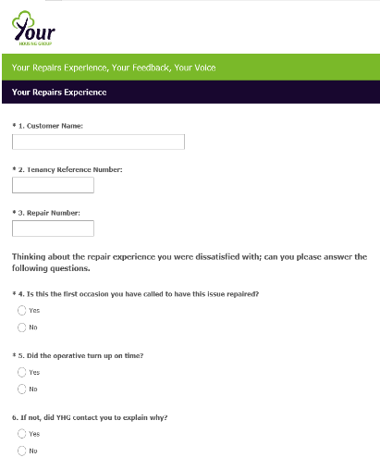
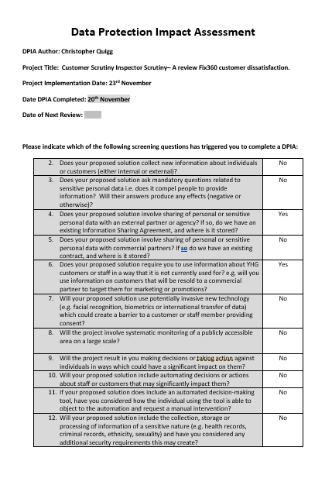
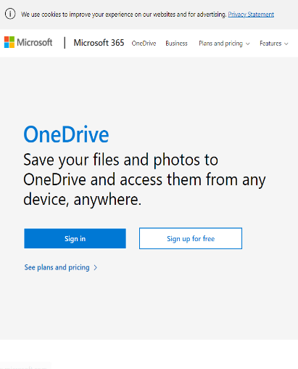

Customer Scrutiny & GDPR
What we did
Internally
Worked closely with YHG’s lead officer for GDPR to ensure the project was compliant
We Identified the legal basis for YHG sharing information with CSI
Ensured the information we were seeking to share was relevant and proportionate to CSI project
We completed a GDPR impact assessment with sign off from lead officer (17 page document)
Externally
Contacted the Information Commissioner Office for advice and guidance on our project
Spoke to peer organisations to gather good practice and tips
Customer Scrutiny Inspectors
  Provided GDPR training through YHG’s internal online training module
  Provided Safeguarding awareness training through YHG’s in-house team
  Provided training on Survey Monkey
  Provided training on OneDrive
  Designed a step by step process, script and FAQ sheet to assist CSI with exercise
  Controls
  GDPR Impact assessment
  Corporate OneDrive digital controls (i.e restrictions on downloads, time limit around access)
  Survey Monkey controls
  Confidentiality and data protection agreement
  Designated safeguarding process
  Risk assessment

Slide 4
CUSTOMER SCRUTINY INSPECTORS (CSI)
Successes, lessons learnt and tips
    Successes
    CSI have been able to undertake and complete their scrutiny review - with no breach of GDPR
    3 CSI members carried out customer calls. *on behalf of the wider CSI group
    120 calls to customers were made between the 10th and 21st December
    CSI were able to record 53 completed surveys.
    2 safeguarding referrals were made by CSIs following calls
    Lessons learnt
    GDPR impact assessment was crucial in documenting our approach in one place.
    It was important to get all stakeholders to have an input in the design of this project; CSI, GDPR lead, ICT, Safeguarding. We successfully achieved this through a working group.
    Safeguarding came up, where CSI members had concerns for customers who they spoke to. It was really important that we took the time to get this right for the project
    Whilst we vetted the data, we did speak to a customer who had a disrepair claim ongoing. Ideally this customer would have been omitted as it is still active.
    Tip
    As we were unable to provide equipment due to lockdown, we were unable to provide phones to CSIs. Due to buy-in during the project design stage, CSI members freely volunteered to use their free minutes as we were struggling to resolve the problem. We thanked them for their contribution by providing £20 voucher each.

Slide 5
CUSTOMER SCRUTINY INSPECTORS (CSI)
My message
Don’t be put off.
It was difficult in the short term… but we did it and now we can apply the same approach without much effort again and again as required

